Slide 1
Drone Pet
Team Members:
Aditya Bansal Dhruv Kaushal
Notes:
Hi, I’m Aditya Bansal, a 4th year Computer Engineering major. This quarter, my team is working on building a Quadcopter that tags to a particular object (like a human being), and records activities like Skiing, Water sports etc. Everybody in our team has prior experience in Robotics and both of us are really excited to work on this project.

Slide 2
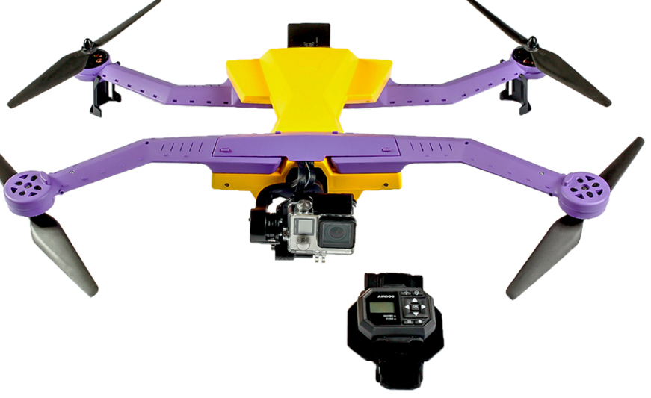
The Problem.
$299
$1599
Notes:
The problem we’re trying to address is the availability of a ready to fly fully autonomous drone that is extremely affordable.
Some of the current solutions are also shown in the images.
You see 2 images here, the one on the left, that is rather affordable compared to other drones. The problem is that it dosen’t have autonomous flight mode, and just has some rather simple mobile apps that you can use to fly it around. At it’s current state, it cannot be used for autonomous missions.
The one on the right, well, is just too expensive. Even though it is capable of shooting videos of recreational sports, it is out of reach for most people.

Slide 3
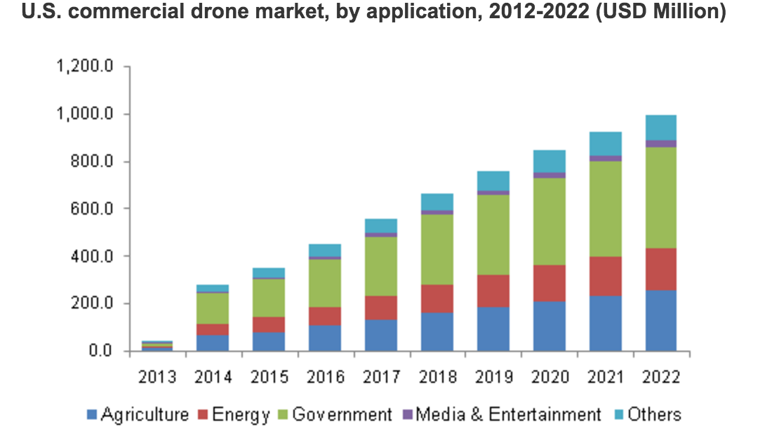
Market
Notes:
As shown above, the drone market is growing rapidly in all kinds of areas. Drones are being used in every field ranging from Military to entertainment, in fact, there are drone racing leagues, where people build there own drones and compete against each other, are popping up across the globe.
That is why we want to tackle this problem; as we see a huge market opportunity, where the big companies like DJI and parrot have only scratched the surface.
Throughout this class, we would like to focus on just the engineering part though, as 10 weeks is not a long time.

Slide 4
Our Goal:
Our goals: 1. Fully Autonomous
2. Easy to set up. 3. Affordable
4. Records recreational sports.
Notes:
Our goal is to have a functional drone that is fully autonomous, easy to set up, and can follow people around taking snaps or recording their activities. It needs to have safety measures so one doesn’t lose their drone, and also needs to be the FAA rules.
Since we’re students and are on a tight budget, we want to make it as affordable as possible.

Slide 5
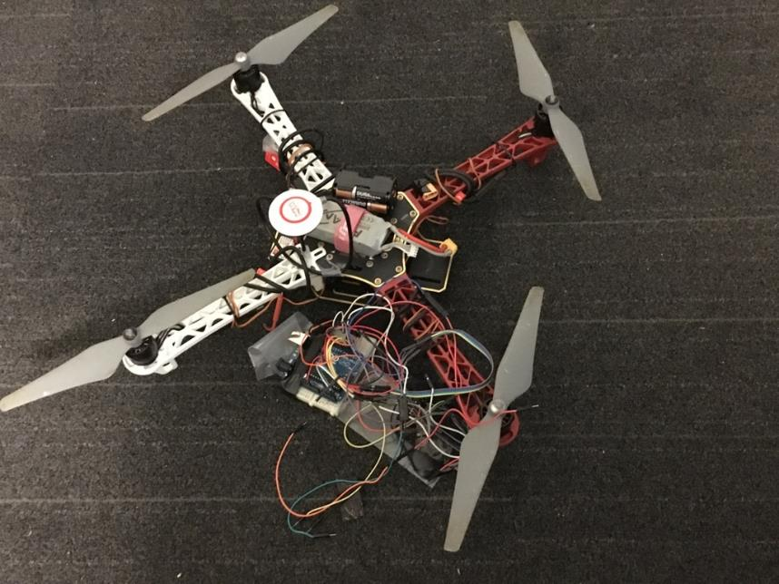
Current Work.
Notes:
Last quarter, I started building a quad copter from scratch. When I ordered the parts, I thought that making a manual quad copter would be damn easy, as I had prior experience in robotics. I just thought it’d be similar o building a Robotic car, just set up the motors and get it up and running in a few hours.
Boy was I wrong. It took literally more than a 100 hours of work to get a half decent thing up and running, and my custom flight controller is nowhere near as strong as the other professional ones.
Sadly, that thing still needs a lot of work and is unstable, and we’re very very far from using this Quadcopter to be an autonomous one.
So for the purpose of this quarter and project, we’d be using a RTF drone, like parrot AR drone and code our own autonomous flight controller. When we achieve this on a drone that is marketed for $299, we show proof of concept, and it wouldn't’t be the hardest thing to port it to an existing project.

Slide 6
Project Focus
Notes:
For this quarter, since we’re using a RTF drone, we wouldn’t be doing any electrical or mechanical engineering. We’ll be focusing on write probabilistic methods in Robotics, like Simultaneous localization and mapping (SLAM), and Kalman Filters, to estimate the location our our drone with respect to the environment. We might also be using OpenCV to read in the video stream that the drone outputs to keep it focused on the moving object. These are very high level ideas of what we plan to implement, and are probably going to change and evolve throughout the quarter.

Slide 7
Thank You!
Questions
Notes:
We look forward to working on our project, and watching the progress of other projects throughout the course. Thank you for your time.

